Slide 1
Insights from the Airbnb, NYC Analysis
For Lead Data Analyst & Data Analysis Manager
Submitted by: Ashish Arora, Suraj Dhamdhere, Abhishek Ranjan

Slide 2
Agenda
Objectives
Initial Understanding & Assumptions about the Data
Background Summary
Important Findings
Training Methods
Appendix - Data Methodology

Slide 3
Objectives
Improve our overall understanding of the impact of Covid-19 on economic and market conditions for the Airbnb Community.
Provide details and gather insights to our Lead Data Analyst & Data Analysis Manager about the impact.
Improve our shared understanding about the challenges and gap we faced during our Research phase and Data Preparation.

Slide 4
Initial Understanding & Assumptions about the Data
Assumed that the data prior to the Covid-19 period was achieving the desired goals.
Currently, Airbnb is particularly looking for New York City — the Bronx, Brooklyn, Manhattan, Queens and Staten Island, followed by their hosts details, prices of the hosted sites and reviews received by the end consumer.
It is assumed that data for some listed properties is not available and there is no data discrepancy.
Availability_365 tells that post pandemic, for how many days listed properties are active for hosting.
We only considered minimum nights and price for a listed property as major source of Revenue for properties.

Slide 5
Background Summary
In the last few months, Airbnb has seen a major decline in revenue due to lockdown imposed during pandemic.
Hence provided the information in hand based on previous data captured, we need to analyze the patterns for declining profits and recommend certain suggestions to overcome.
Airbnb NYC has 5 Neighborhood groups and 221 Neighborhoods with 3 different room types.

Slide 6
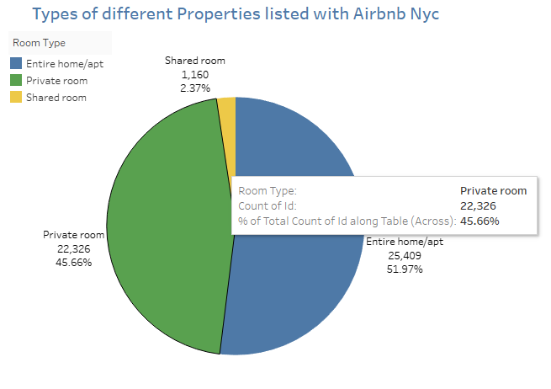
Important Findings
Out of all listed properties, Entire home properties counts for 25,409.
Followed by that, 47% of Listed properties host Private rooms
Only 2.37% Shared rooms are there.

Slide 7
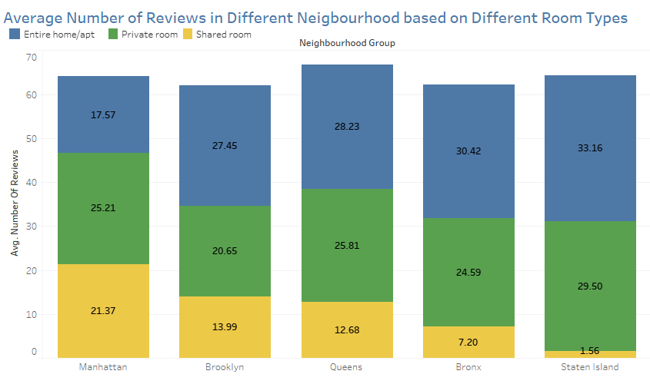
Street Island gets the highest average number of reviews.
Considering less number of properties are listed there, we can assume that customers are facing more issues and may reviewing as complains.
Customers at this place should be reviewed or sentimental analysis of these reviews should be done again.

Slide 8
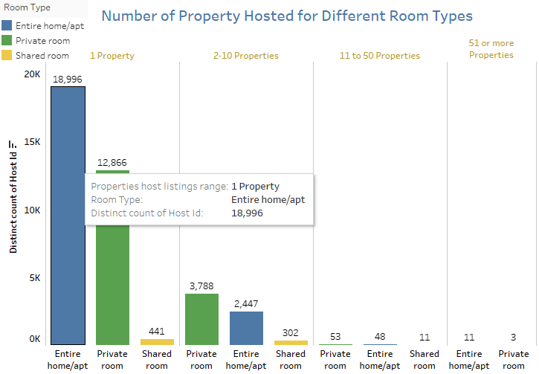
Host which host only 1 property mostly has Entire Home followed by private rooms.
Same trend is seen by the host who holds 2-10 properties.

Slide 9
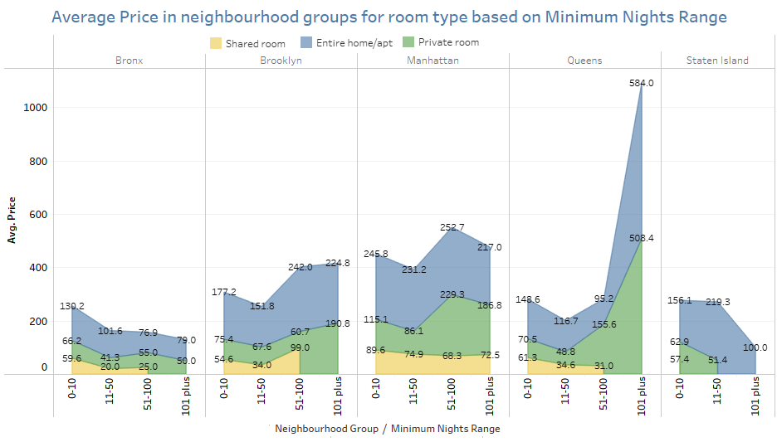
As the night increases, the average price of listed properties is going down. Except if minimum nights are in range 51-100.
Average price is very high at Queens if nights are hosted for more than 100 days.

Slide 10
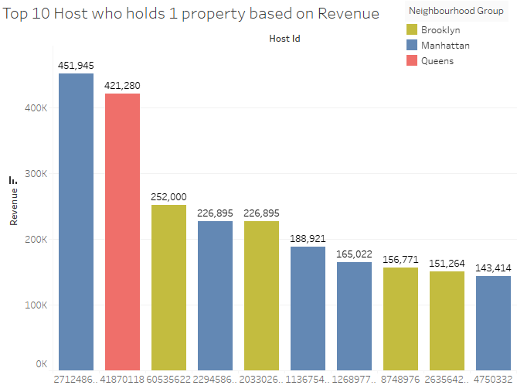
Most host have 1 property.
Considering that, 5 hosts are from Manhattan and 1 from Queens and 4 from Brooklyn.

Slide 11
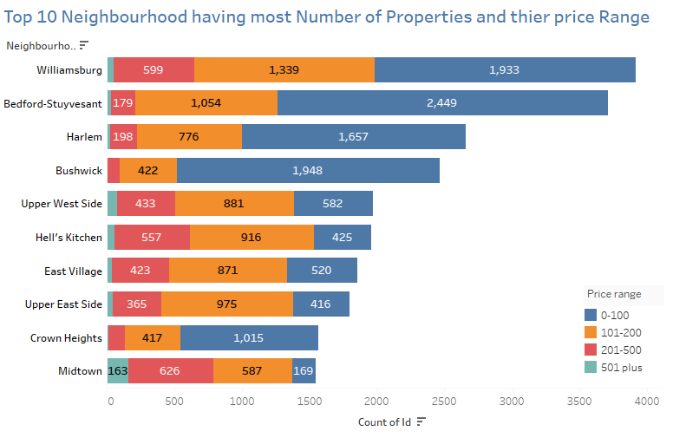
Neighbourhood which has most number of properties prefers a price range of 0-100 and then followed by 101-200.
Williamsburg, Belford-Stuyesant and Harlem has the most number of properties in their neighbourhood.

Slide 12
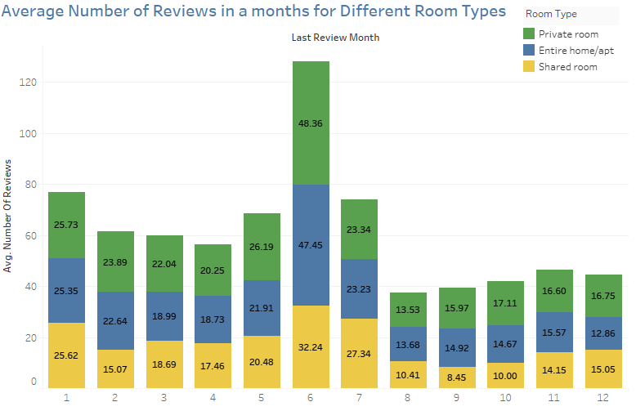
On Average, all months share almost same average, except the month of June.
At the start of year, average number of reviews are more and as the year proceeds these average reviews are going down.
Average Number of reviews for:
Private Room – 16-25
Entire Home – 12-25
Shared Room – 8-25

Slide 13
Conclusion
Price review of properties hosted in Manhattan.
Entire Home contributes to 44 million of Revenue.
Likelihood of Private room getting booked is twice of hosting once and 5 times for entire home.
Properties which are available for 200+ days are more likely to be profitable.
We should interact with hosts who are hosting more than 50 properties and introduce them in Marketing ads which may help in acquiring more hosts in neighbourhood.
Reviews should be through analyzed and sentimental analysis should be done on them.

Slide 14
Training Methods
Treated Missing Values:
For name and host name we filled the missing values with name not known.
For last_review, we filled the null values with DUMMY DATE.
For reviews per month, we filled missing values with mean reviews in their respective neighbourhoods.
Outlier Treatment:
Post analysing and treating the missing values accordingly we treated the spread in the data frame i.e. outliers.
Used Z-Score Method to find and capped accordingly.
Data Wrangling:
Binning numeric columns to build a categories column from them.

Slide 15
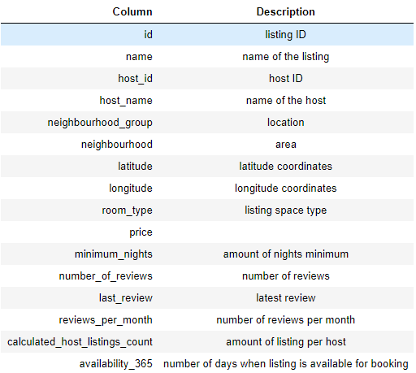
APPENDIX - DATA SOURCES
The New York Airbnb Dataset includes information on various Airbnb listings, including their hosts, locations, pricing, and other characteristics. The dataset's columns are self-explanatory.
We reviewed the dataset description on the right to gain a better understanding of what each column represents.

Slide 16
Appendix – Data Methodology
Appendix – Data Methodology
Methodology Approach
Research Problem
Business Understanding
Type of Data Require – Data Source
Whom are we presenting?
Analysis Done
Recommendations
Analysis Methodology
Data Understanding and Preparation
Variables overview
Handling missing values and outliers
Feature selection / engineering
Analyzing methods
Evaluation of Methods
Finding and Insights
**Note: Please Refer Methodology Document for complete details.

Slide 17
Thank You

